Slide 1

STOCK MANAGEMENT SYSTEM
Project presentation

Slide 2
NAMES | REGISTRATION NUMBER
KWIZERA Pacifique | 220006361
MWUMVANEZA Emmanuel | 220001040
MAKOMBE Cedrick | 219002281

Slide 3
INTRODUCTION
The Stock Management System refers to the system and processes to manage the stock of an organization with the involvement of a Technology system
The aim was to make a web based application which can manage an inventory or a stock of business unit medium to small.
This system can be used to store the details of the inventory, stock maintenance, update the inventory based on the sales details, and generate sales and inventory reports daily or weekly based.

Slide 4
PROBLEM STATEMENT
Managing stock using books and registering things by hand can lead to a lot of unwanted errors and unnecessary human labor and all of this leads to extra expenditures of a business unit.
But with the help of a system to take care all of this work, human errors can be reduced on a high contrast

Slide 5
users of this system
The customer: after login, able to view available products and add to cart what they prefer and then pay.
The warehouse manager: after login, able to view all products and create new products
The shipping manager: able to view orders ready for shipping, assign drivers for delivery and register new drivers
The driver: logins to view the current assigned tasks
The super admin: after login, he/she can do any of the actions done by any of the other managers and other advanced actions like revoking roles and permission

Slide 6
Features of the system
This application is basically used to show the stock remaining and details about the sales and purchases. More details are below:
Login page: for secure authentication
Sign-up page: for registering new users
Shop page: to allow customers to view and purchase products
Dashboard: a dynamic page which is displayed accordingly the users roles and permission to the system
Products management: the warehouse manager is able to create new products and monitor other aspects like expiry dates.
Orders: the super admin is able to approve orders before they are delivered to buyers

Slide 7
Features of the system(…)
Shipping management: the shipping manager is able to view available delivery tasks available and then assigns them to available drivers, this manager can also register new drivers and remove them from the system.
Authority management: only accessible by the super admin, any user of the system can be given a specific role by the admin and these roles come with specific permissions
Cloud storage of system files: we used Cloudinary storage to store the system files like images and backup files, log files.

Slide 8
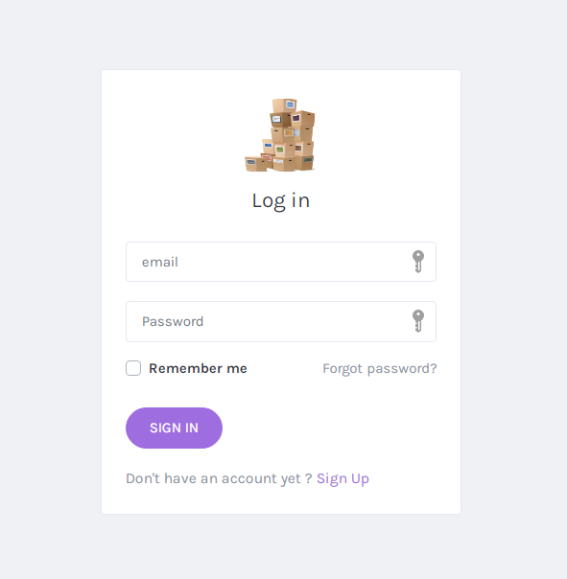
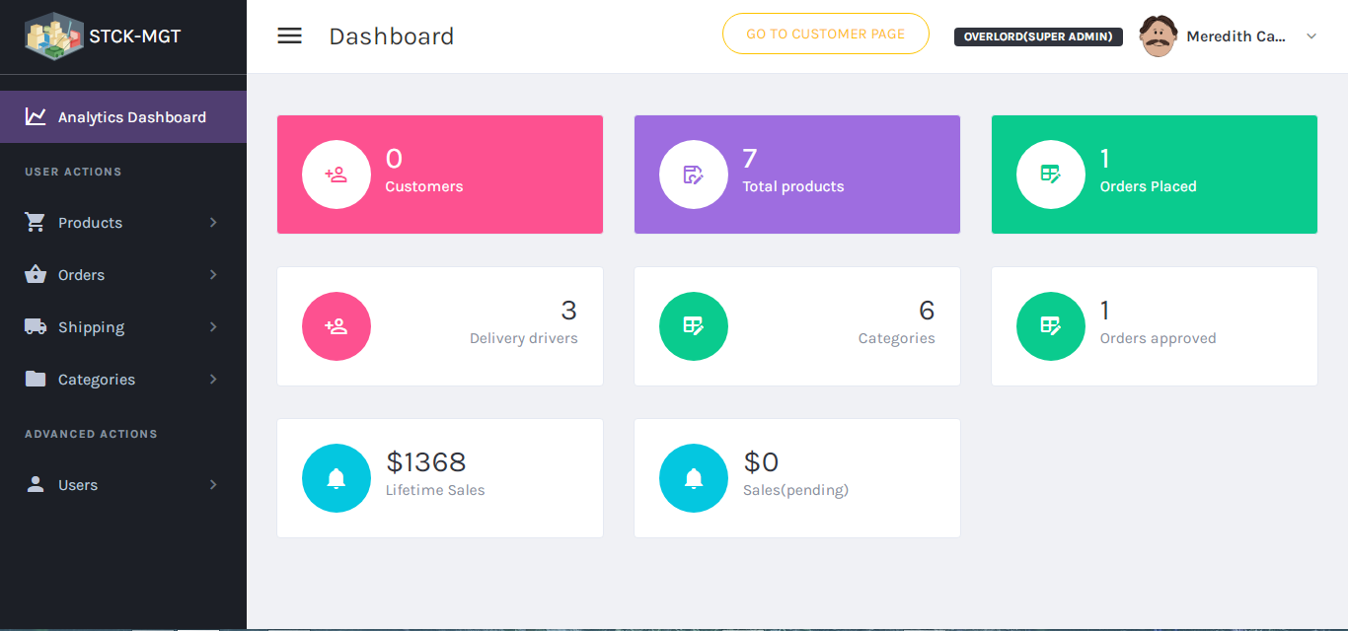
Some visuals

Slide 9
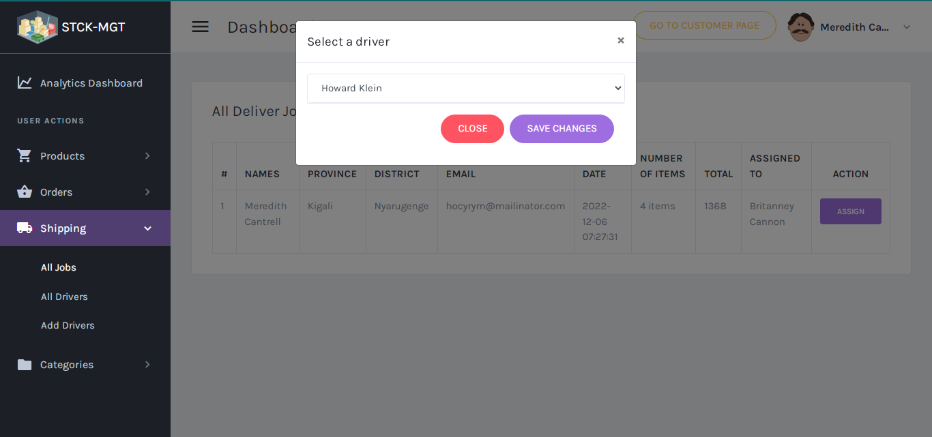
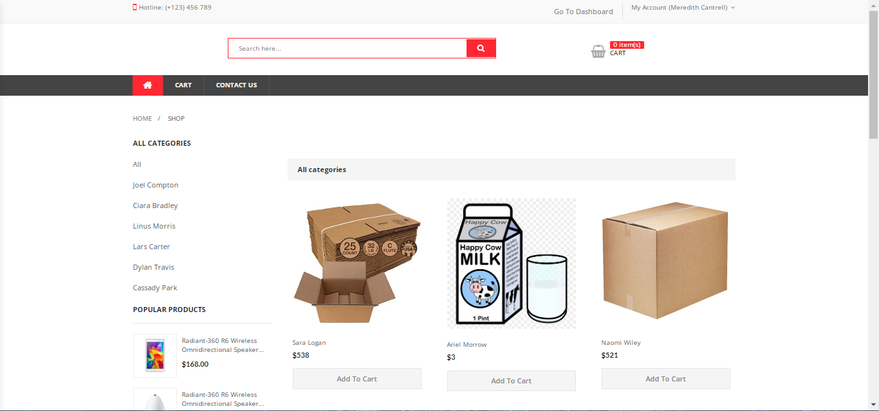
Some visuals(…)
More can be seen in the demonstration.

Slide 10
Unfinished business
This project needed a massive amount of time so it was hard to accomplish everything that was on the objectives list, the following are the features we weren’t able to develop in time:
Payment: couldn’t implement stripe payment
Driver’s section: currently the features for delivery drivers are not usable
Error logging: we intended to implement error logging for easy debugging.
Deployment: the system is not yet hosted online due to the above mentioned missing features.

